Slide 1
ESG Training Program
Pro Climate Impactors

Slide 2
Training Program Particulars
Who
What
All PCI employees & associated vendors as desired (MP, 10/6, NPUC, Gulch)
Intro, Specific Application, Follow On
When
Where
Bi-Annually and then Follow on Quarterly, Beginning June 2022
Virtual, In Person

Slide 3
Introductory Section ESG 100

Slide 4
Prerequisites
Foundational Training for All
ESG 101
Introduction to Climate Change – Aviva’s Course
ESG 102
ESG Definitions & Usages
ESG 103
The Ecological Economy

Slide 5
PCI & ESG Sections 200, 300

Slide 6
How it all fits togheter
MP in ESG
Org Dev
Change Adoption
Data Innovation ​
10/6 in ESG
Project Management
Project Controls
Scheduling Analysis
PCI in ESG
MP & 10/6 Indirect into:
NPUC
The Gulch Environmental Foundation
Deep Dive
NPUC
The Gulch Environmental Foundation

Slide 7
Continued Education Section 400

Slide 8
Quarterly Learnings
Intro
Courses​
Quarterly Learnings​
2022
Jan
Feb
Mar
Apr
May
Jun
Jul
Aug
Sep
Oct
Nov
Dec
Intro
Courses
Quarterly Learnings​
Intro
Courses​
Quarterly Learnings​
2023
Jan
Feb
Mar
Apr
May
Jun
Jul
Aug
Sep
Oct
Nov
Dec

Slide 9
Ecological Economy ESG 103

Slide 10
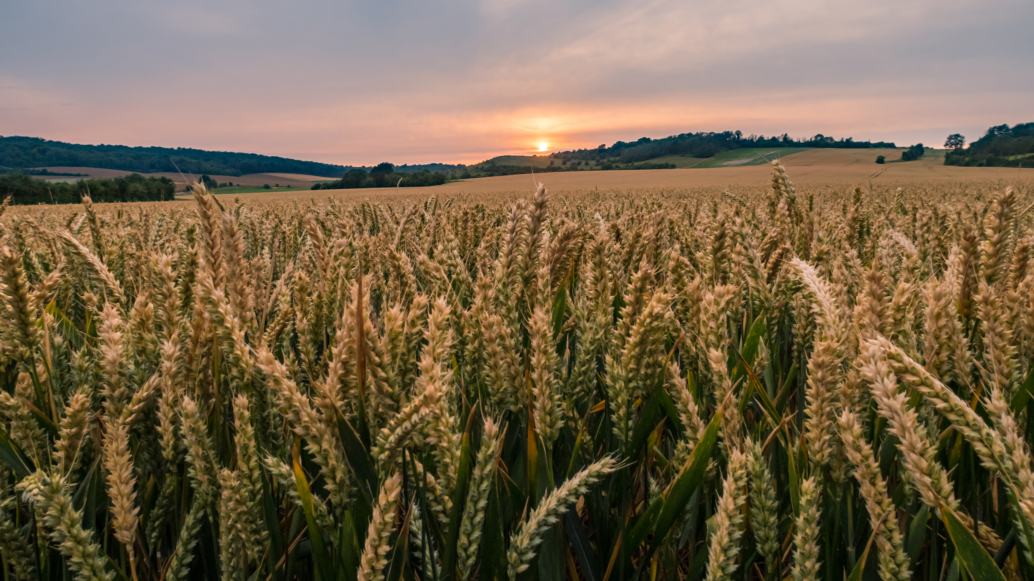
Overview

Slide 11
The Ecological Economy - Overview
Definitions & Economies through the decades
Economic Trends in Business
Economic Trends in Consumerism
What this means for us: Application
Conclusion & Q&A

Slide 12
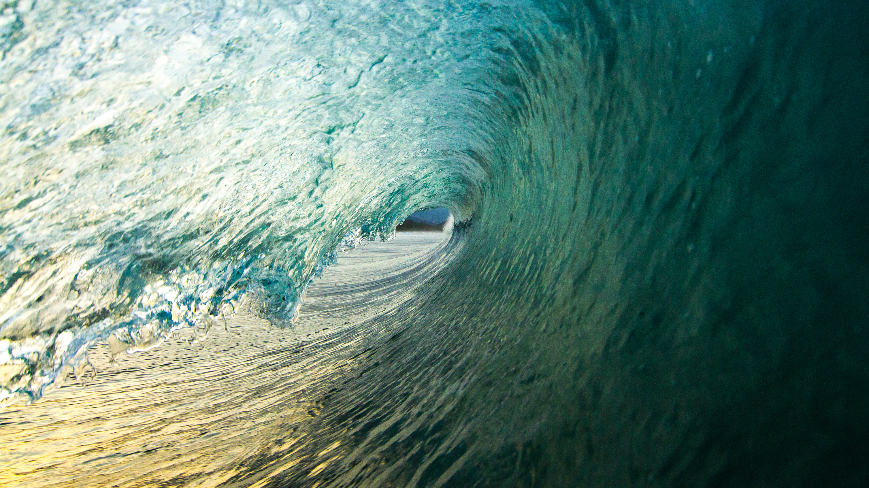
Definitions and Economies

Slide 13
Definitions
Ecological Definition: adjective
relating to or concerned with the relation of living organisms to one another and to their physical surroundings.
"pollution is posing a serious threat to the ecological balance of the oceans"
Economy Definition: noun
the wealth and resources of a country or region, especially in terms of the production and consumption of goods and services.
careful management of available resources. "even heat distribution and fuel economy“
Economy Definition: adjective
(of a product) offering the best value for the money. "an economy pack“
ESG – Investing - https://www.investopedia.com/terms/e/environmental-social-and-governance-esg-criteria.asp

Slide 14
Definitions
Ecological Definition: adjective
relating to or concerned with the relation of living organisms to one another and to their physical surroundings.
"pollution is posing a serious threat to the ecological balance of the oceans"
Economy Definition: noun
the wealth and resources of a country or region, especially in terms of the production and consumption of goods and services.
careful management of available resources. "even heat distribution and fuel economy“
Economy Definition: adjective
(of a product) offering the best value for the money. "an economy pack“
ESG – Investing: https://www.investopedia.com/terms/e/environmental-social-and-governance-esg-criteria.asp

Slide 15
Economic Styles
60’s, 70’s & 80’s
Functional Organizations
You would start and engineer, climb the engineer ladder and likely retire having worked as an engineer in a department of engineers for 1 or 2 companies in your lifetime
90’s, 2000’s, 2010’s
Projectized Organizations
Still and engineer you are now assigned to different projects and build your career based on the types of projects you have worked on, working at multiple companies in your lifetime
Now and Later – The Emerging Ecological Economy
ESG Organizations
Still an engineer, still on projects, now you work on projects that have an ESG focus in one way or another

Slide 16
Economic Styles
60’s, 70’s & 80’s
Functional Organizations
You would start and engineer, climb the engineer ladder and likely retire having worked as an engineer in a department of engineers for 1 or 2 companies in your lifetime
90’s 2000’s, 2010’s
Projectized Organizations
Now and Later
Still and engineer you are now assigned to different projects and build your career based on the types of projects you have worked on, working at multiple companies in your lifetime
The Emerging Ecological Economy -ESG Organizations
Still an engineer, still on projects, now you work on projects that have an ESG focus in one way or another

Slide 17
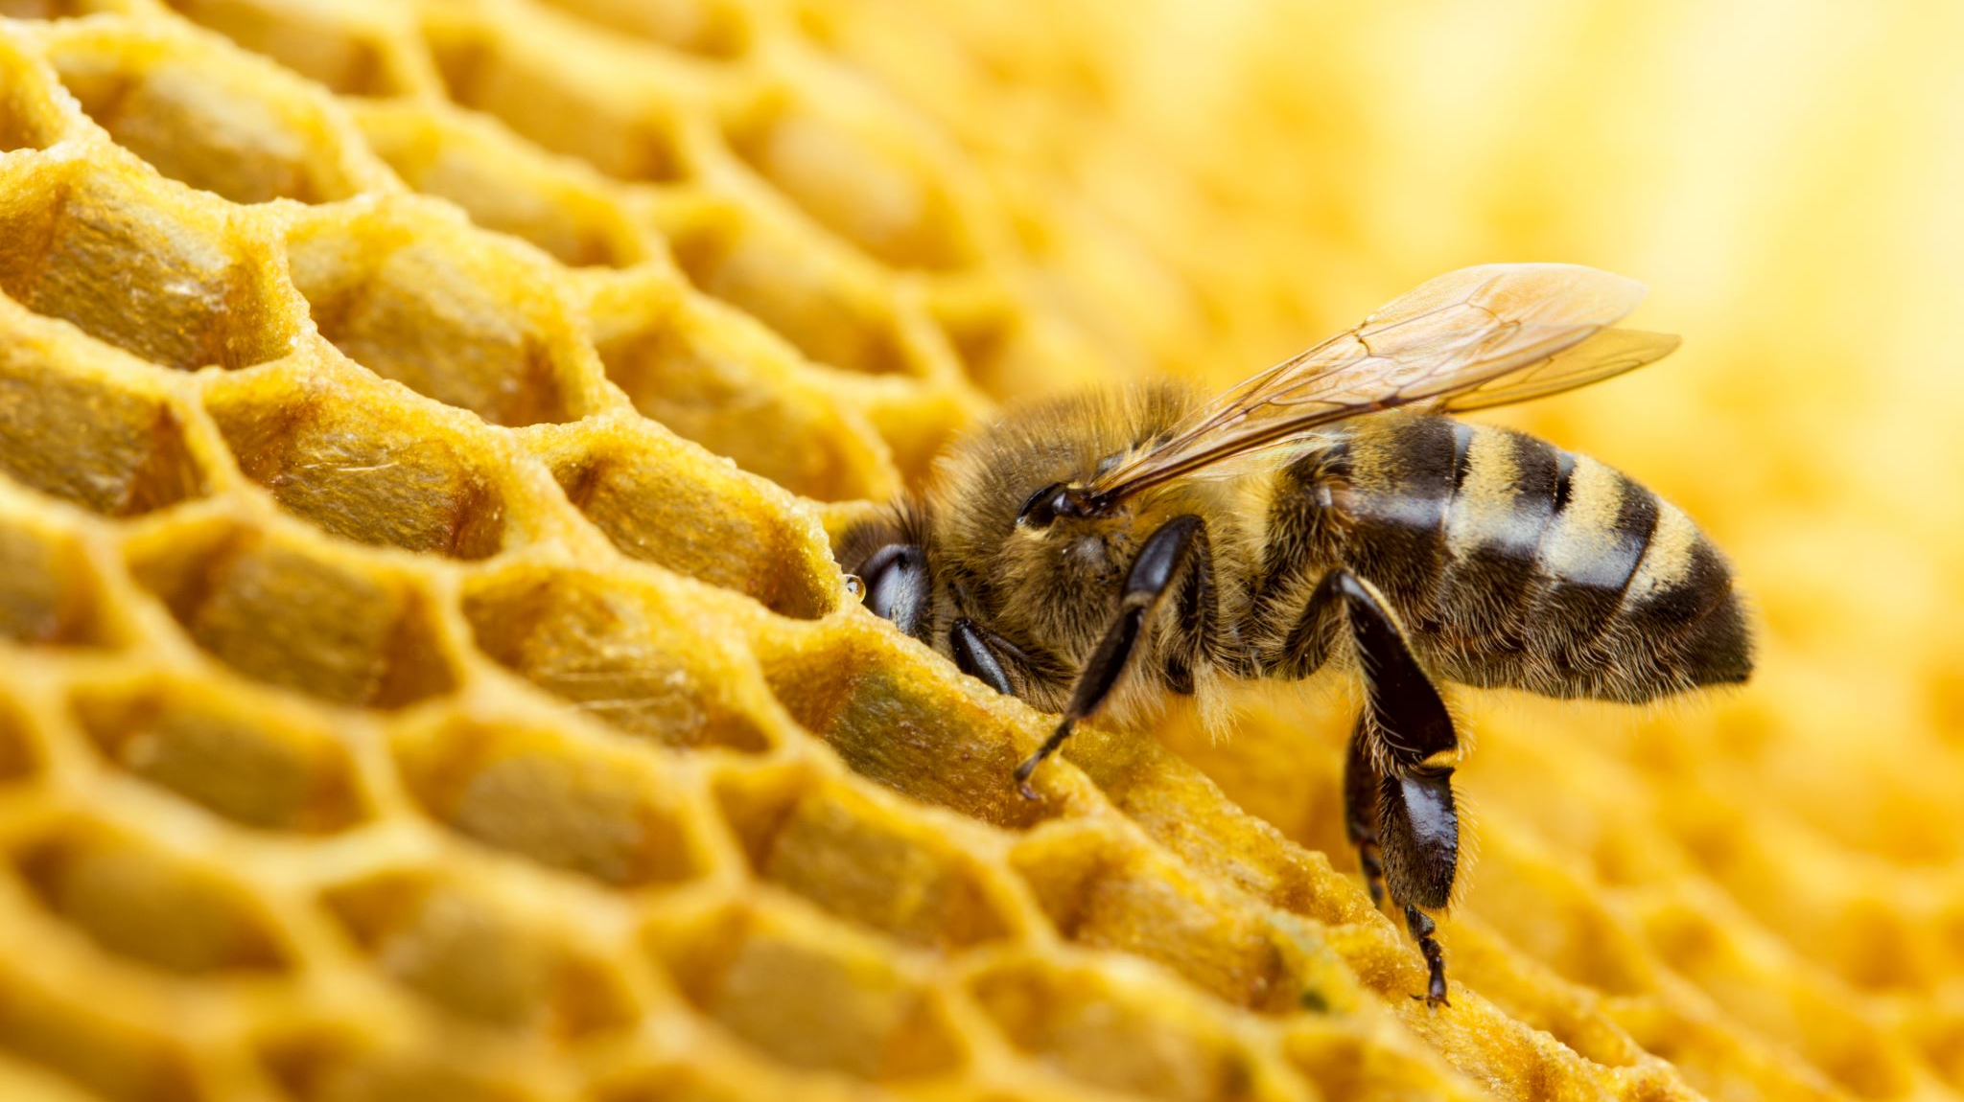
Trends

Slide 18
Economic Trends
Economic Trends
75% of silicon valley companies have an CSO
49% have DEI programs with 79% raising budgets in 2022.
BOC’s 1.5% Set aside
With “92% of global companies adapting their business strategy and model to be more sustainable and plan to increase investment in sustainability initiatives to improve ESG performance in 2022” - Verdantix
80% of leading companies around the world now report on sustainability – KPMG
Multi industry cooperation – Duke/ATT & Honeywell

Slide 19
Economic Trends
Global
With “92% of global companies adapting their business strategy and model to be more sustainable and plan to increase investment in sustainability initiatives to improve ESG performance in 2022” - Verdantix
United States
49% have DEI programs with 79% raising budgets in 2022
80% of leading companies around the world now report on sustainability – KPMG
California
75% of silicon valley companies have an CSO
BOC’s 1.5% Set aside representing $600M in contracts

Slide 20
Product & Service Trends
A good example: Ford
Used to be able to get one in any color as long as ?
Now also a household generator and onsite tool powerhouse
Greenwashing
Common in nature – if you don’t want to get eaten, look like something that is poisonous – or if you don’t want you business to die, look like a sustainable company
State and Federal
Carbon offset programs
Carbon taxes
Federal & administrative mandates

Slide 21
Product & Service Trends
Ford
Used to be able to get one in any color as long as ?
Now also a household generator and onsite tool powerhouse
Product & Service Trends
Greenwashing
Common in nature – if you don’t want to get eaten, look like something that is poisonous – or if you don’t want you business to die, look like a sustainable company
State and Federal
Carbon offset programs
Carbon taxes
Federal & administrative mandates

Slide 22
Product & Service Trends
A good example: Ford
Used to be able to get one in any color as long as ?
Now also a household generator and onsite tool powerhouse
Greenwashing
Common in nature – if you don’t want to get eaten, look like something that is poisonous – or if you don’t want you business to die, look like a sustainable company
State and Federal
Carbon offset programs
Carbon taxes
Federal & administrative mandates

Slide 23
Consumer Trends

Slide 24
Consumer Trends
Electric cars
After a decade of rapid growth, there are now over 10 million electric cars on the road, representing ~1% of the global car stock. For 2030, the Net Zero Emissions by 2050 Scenario projects 300 million electric cars on the road and they account for over 60% of new car sales, compared with only 4.6% in 2020.
Solar
Today, the 2 million residential, commercial and utility-scale solar installations produce enough electricity each year to power more than 12 million American homes. By 2024, 2.5 percent of all U.S. homes will have a solar installation.
How big is the green consumer market?
Is green yet more than a fad? The Lifestyles of Health and Sustainability annual survey estimates that 13-19% of American adults are dedicated green buyers – a $290bn market. The US-based Cone Communications estimates that 70% of American consumers consider the environmental impact of their purchasing.

Slide 25
True or False
When I go to the grocery store I look to see where my meat/fish come from and how it is farmed
Where I live I am considering battery back up or generator to power my home in case of a weather event or power outage
I am or have already bought a hybrid or electric vehicle
I am actively or looking to reduce single use plastics in my home
I compost
I couldn’t believe the video on fast fashion in Chile and am ready to board a bus in the morning to go help clean it up
Carbon labeling is on the rise
I think Angel’s collapsible to go constrainers are cool and Angel is even more cool for using them

Slide 26
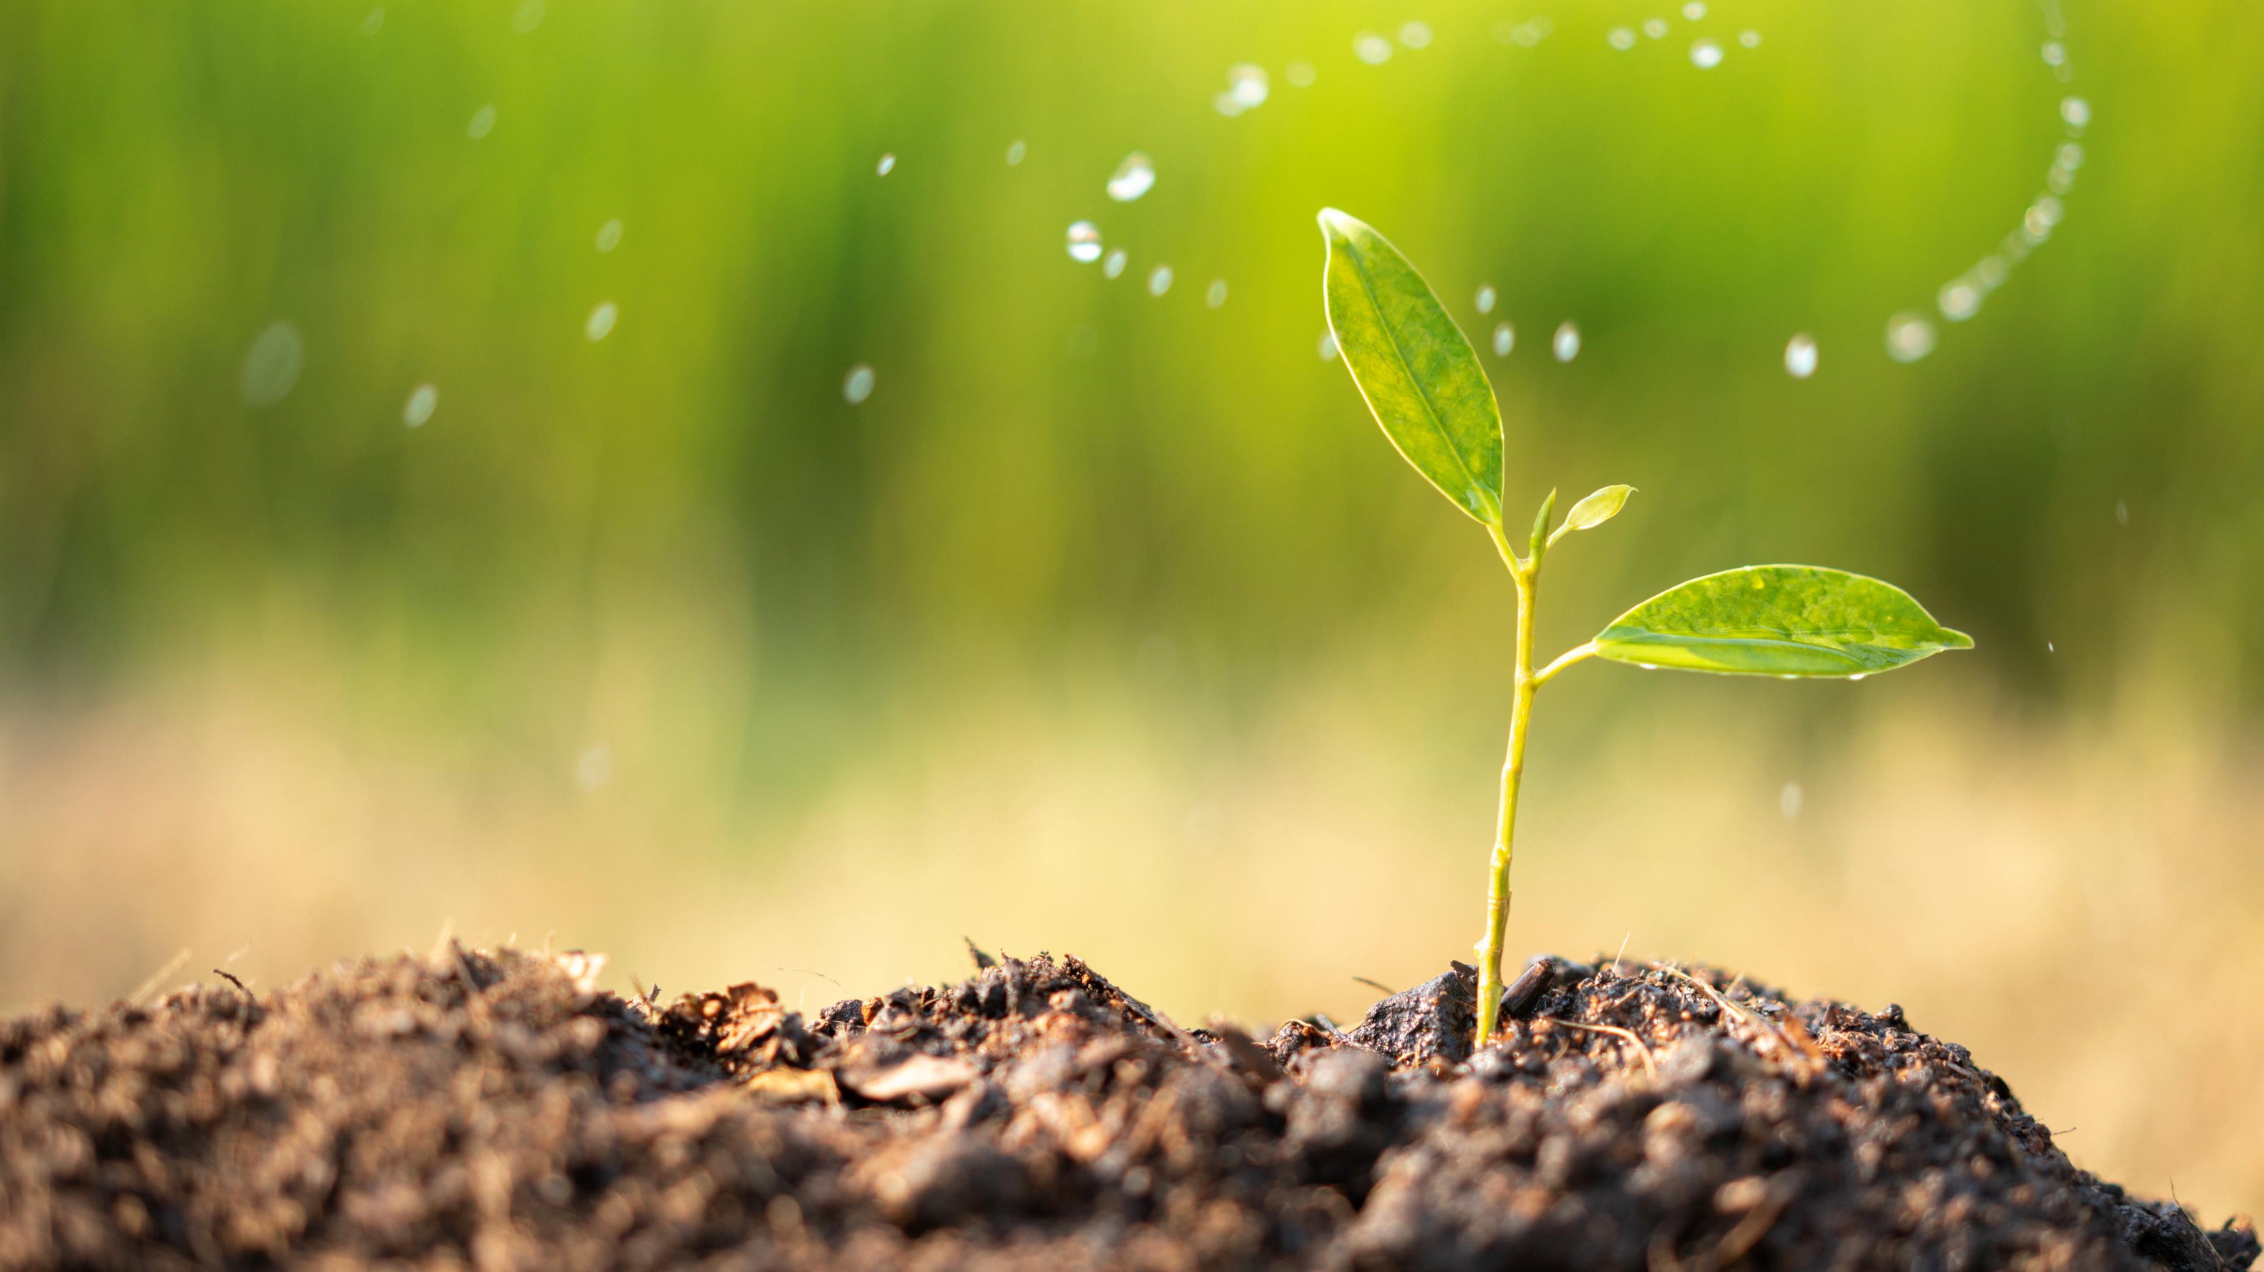
Application

Slide 27
Application: Where do we Fit?
Facilitating our Vision!
To initiate drawdown. To accelerate decarbonization. To aid in getting to net zero within the utility industry and associated industries and to transform the agricultural industry to regenerative farming
What the business world is doing and how we must adapt to it
Have meaningful impact on the world (NPUC etc., )
Mission Driven Service Line Development that makes money – Research (data) and Advise (consulting) to institute Change (change adoption) on ESG matters – e.g. help utilities understand their decarb commitments, educate clients, tie existing work in with a clients ESG stance, etc., More to come in next modules
Walk our talk – and use our powers for good – abide by the principals we teach (carbon footprint calc, BOC assistance, Students rising above, NPUC, Gulch, all of it)

Slide 28
Pro Climate Impactors Family of Companies
Capital Project Delivery Consultation & Services
Research & Thought Leadership
Measurable Carbon Sequestration
rations
Organizational Development
Capital Project PM
Marketing
Scientific Regenerative Farming
Change Adoption
Capital Project Controls
Research
Team Building Farm Trips
Systems Implementation
Operations Management
Data Innovation
Capital Project Scheduling
Advisory
Information & Insight
Company & Employee Impact

Slide 29
Interacting with ESG
Our Family of Companies
Our Clients
Service line: On their interaction with ESG’s
MP’s application
10/6 application
NPUC
The Gulch application
And our own ESG plans
Our company reporting
Our carbon sequestration
Philanthropy
Hiring practices/upkeep
Utilities
Race to Net Zero
Municipalities
Transportation
Commodities
Agriculture practices
Medical Device
Medical Waste

Slide 30
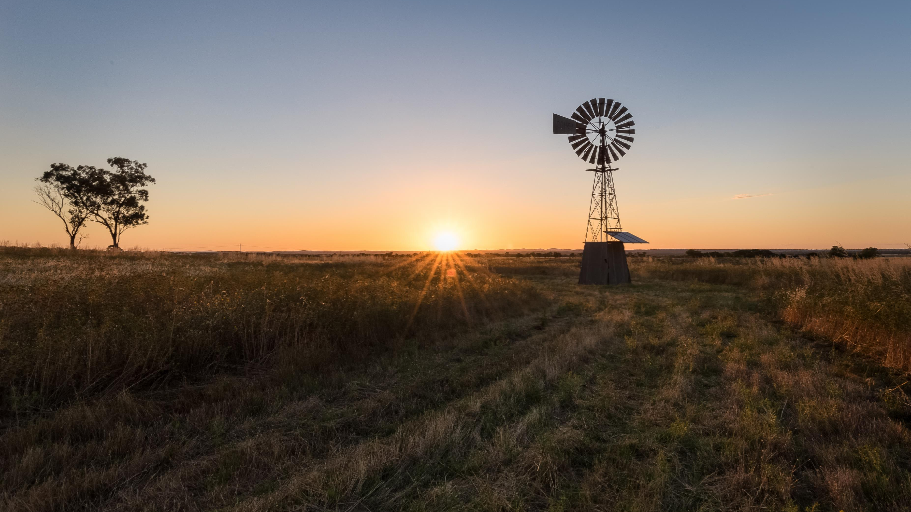
Conclusion

Slide 31
To Sum it all up
The Ecological Economy is here and we as a viable business have a unique opportunity to adapt to it
Though this training program we will be one of the few work forces that are trained on ESG thinking and its business application – not only for our own business but for our clients as well
You will have an added advantage in your career going forward with this education and practice under your belt
The work you do is more impactful than you may have realized

Slide 32
Q&A

